Slide 1
Smart Garden
Ben Smith & Jiana Kambo

Slide 2
Project Overview
Smart Garden is a connected device that:
Monitors temperature, humidity, soil moisture, light, and water level
Automates watering based on environmental conditions
Uses Arduino for real-time processing
Uses Raspberry Pi (LAMPI) as the front-end to interact with the system
Uses Django website to display real time data, show historical trends and also control the water pump and set threshold values.

Slide 3
Setup
Arduino collects data from:
Soil Moisture Sensor
Water Level Sensor
Light Sensor
DHT11 for Temperature and Humidity
Pump connected through a Relay
Use API endpoint to communicate bi directional from the django website and the pi
Website shows information about the plant and lets you control the plant
Real-world testing with a live plant

Slide 4
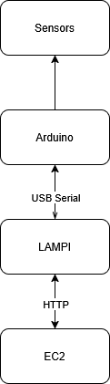
Architecture

Slide 5
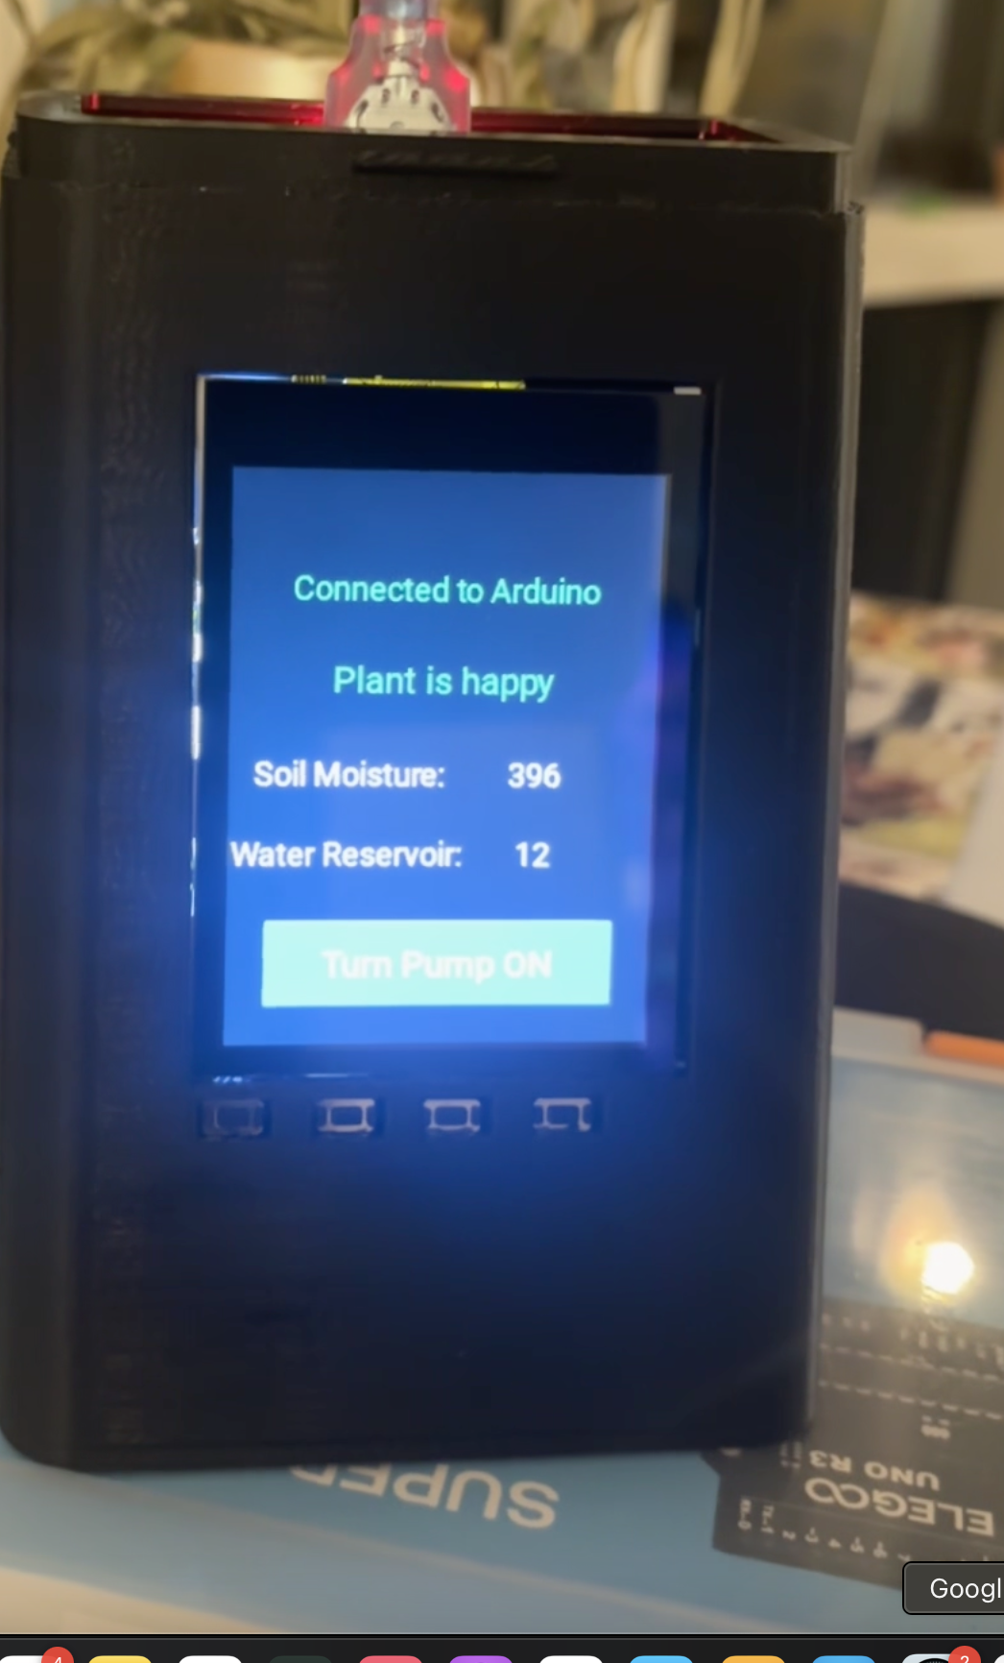
On the Pi
Serial communication over USB
JSON-formatted data exchanged every 2 seconds
Kivy UI on Raspberry Pi displays:
Moisture, Reservoir Level
User can toggle pump on/off via Pi
Shows if you are connected to Arduino
Only essential information shown here

Slide 6
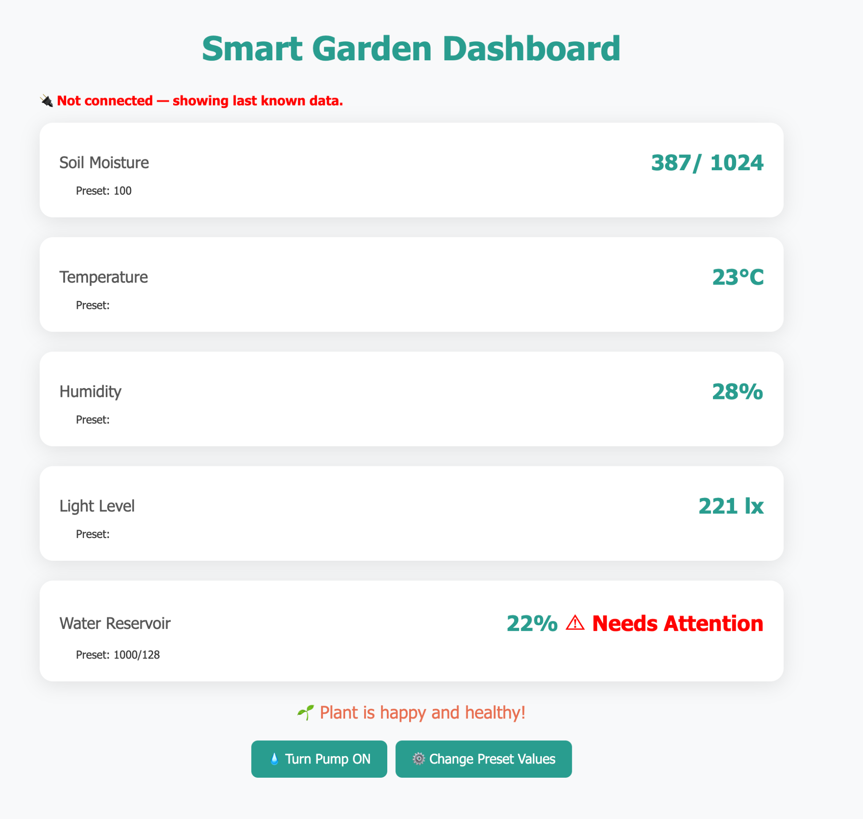
Website
Shows real time data from the arduino unless not connected.
Can water the plant manually from here as well
Can change the preset values
Shows what needs attention
Preset value used for smart watering
Shows graphical trends

Slide 7
Smart watering logic
Uses running average of last 10 readings
Waits for moisture readings to stabilize before re-watering
Prevents overwatering caused by premature readings

Slide 8
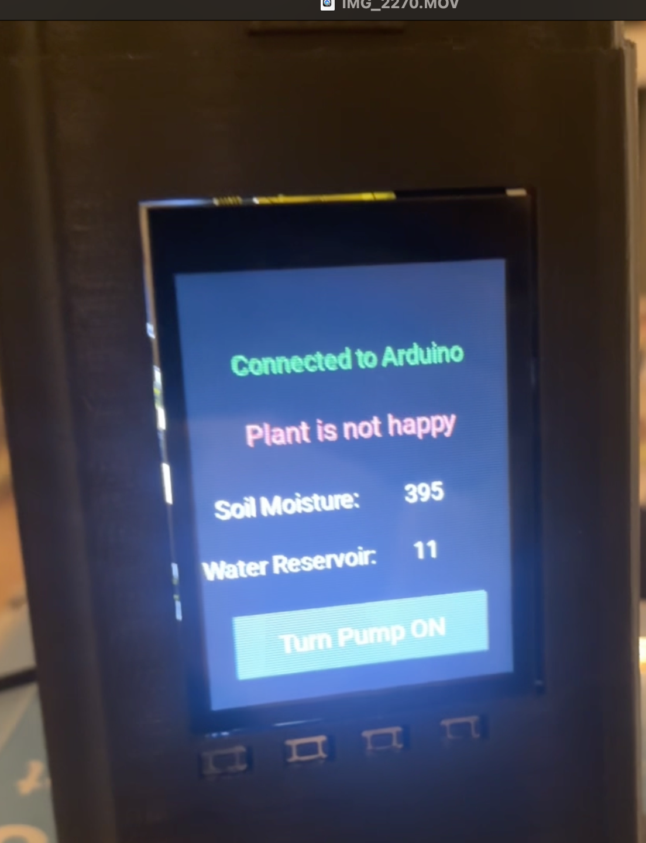
Plant is happy vs not
As long as the plant is above the soil moisture level we classify the plant is happy, if it is not that is communicated to the pi and the website and the user knows to give their plant the needed love

Slide 9

Demo

